Slide 1
Abstract Art
I paint objects as I think them, not as I see them.
-Pablo Picasso

Slide 2
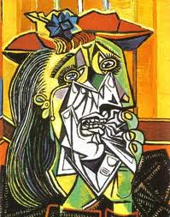
Abstract artists are interested in
the design on the canvas and how the various parts relate to each other

Slide 3
3 Important Styles
CUBISM
FUTURISM
DE STIJL

Slide 4
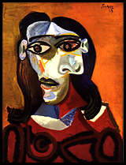
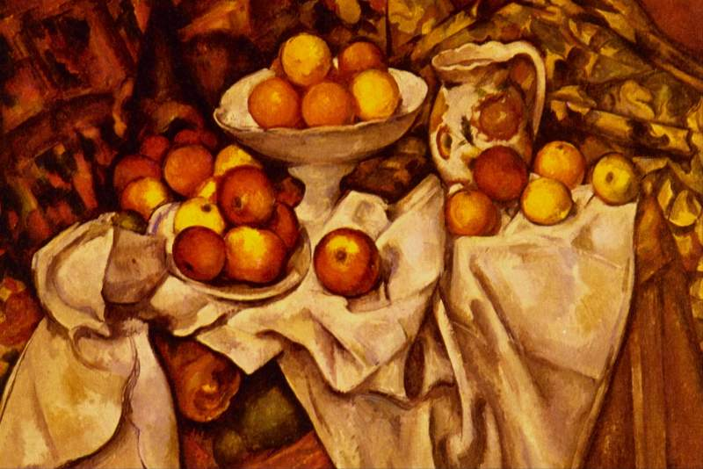
CUBISM
Began in 1907 by Pablo Picasso
Used artist Paul Cezanne’s ideas that all shape
in nature are based on the sphere, cone and
cylinder

Slide 5
Pablo Picasso
Born in Spain, spends most of art
career in France
Has many techniques and styles
-constantly changing
*Blue Period
*Rose Period
*Analytical Cubism
*Synthetic Cubism

Slide 6
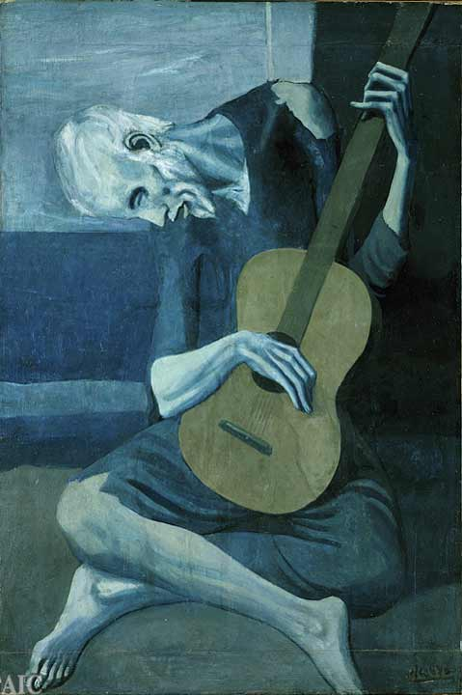
BLUE PERIOD
Pablo Picasso
-The Old Guitarist

Slide 7
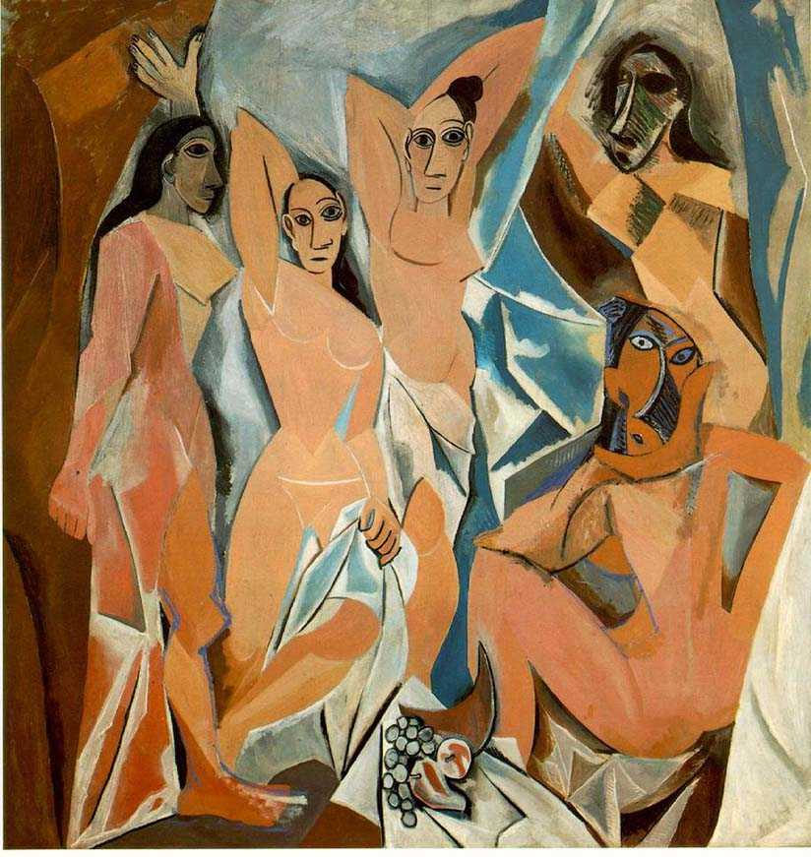
Les Demoiselles d’Avignon, 1907

Slide 8
The relationships of the shapes and colors
were most important to Picasso
This painting started the cubism
movement
Picasso was inspired by African mask art
during this time

Slide 9
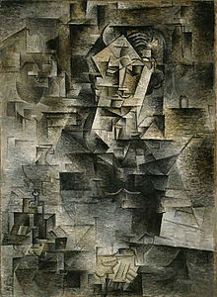
Analytical Cubism
Picasso
-Daniel Henry Kahnweiler, 1910
The shapes in this painting
are broken down further into smaller,
crisp shapes and monochromatic
shades of color
No interest in perspective
Uses neutral colors
Geometric pattern

Slide 10
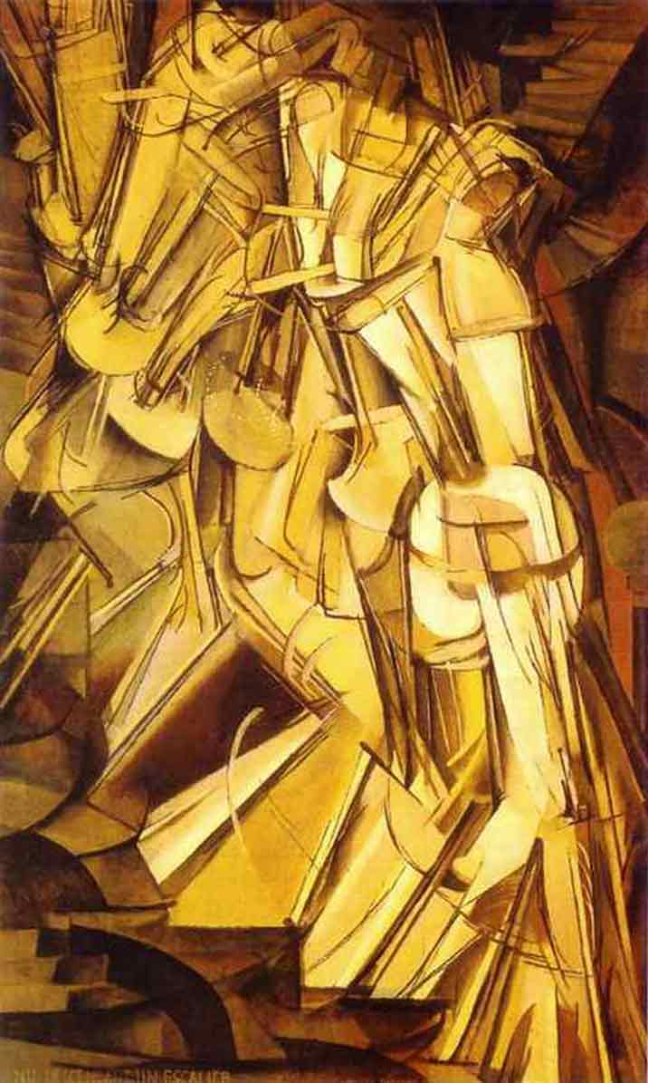
MARCEL DUCHAMP
Nude Descending A Staircase, No. 2, 1912
One critic called it, “An explosion in
a shingle factory”
A series of movements stopped in
successive stages of action
This image is like being caught in a
Strobe light or a stop-action film
He captured movement

